Slide 1
Comparative Analysis of MS2 and MS3 Approaches in Large Language Models (LLMs)
Implementation, Evaluation, and Discussion
Ahmed Wael
Omar Mamdouh
5/19/2024

Slide 2
Introduction

Slide 3
Overview of the Task
Objective: Classify user queries as related to either Android or iOS.
Dataset: Contains user queries, split into training and testing sets.
Goal: Develop a model that accurately predicts the platform based on the query text.
Approach: Utilize natural language processing (NLP) techniques and machine learning models to achieve the classification.

Slide 4
Importance of Preprocessing in NLP
Text Cleaning: Remove noise (e.g., HTML tags, punctuation) to improve data quality.
Tokenization: Split text into meaningful units (tokens).
Stopword Removal: Eliminate common words that add little value to the analysis.
Lemmatization: Convert words to their base forms for uniformity.
Impact: Enhances the accuracy and efficiency of the model by ensuring clean, relevant input data.

Slide 5
Model Selection for Large Language Models (LLMs)
Why BERT?: Bidirectional Encoder Representations from Transformers (BERT) is chosen for its robust performance in NLP tasks.
Model Used in MS3: Tiny BERT (prajjwal1/bert-tiny) for its efficiency and capability.
Binary Classification in MS2: Utilized simpler binary classification techniques for initial model training and evaluation.
Advantages: BERT models are pretrained on a vast corpus, allowing them to understand language nuances.
Considerations: Balancing model complexity with computational efficiency to suit project needs.

Slide 6
Post-Processing in LLMs
Objective: Refine model predictions to enhance accuracy and usability.
Steps:
1- Prediction Adjustment: Fine-tune predictions based on confidence levels and thresholds
2- Error Analysis: Identify and rectify common misclassification patterns.
3- Interpretability: Ensure results are interpretable and actionable.
Impact: Improves the practical applicability of the model in real-world scenarios.

Slide 7
Introduction to MS2 and MS3 Approaches
MS2 (Multistep 2):
- Description: A two-step approach involving initial preprocessing and primary model
training using binary classification.
- Application: Sets the foundation for model development with basic preprocessing and
training.
MS3 (Multistep 3):
- Description: An extension of MS2, utilizing Tiny BERT for advanced preprocessing,
fine-tuning, and enhanced model training.
- Application: Utilized for refining models, incorporating more complex preprocessing,
and optimizing performance.
Benefits: Provides structured methodologies to systematically develop and improve machine learning models.

Slide 8
Post-Processing in LLMs
Objective: Refine model predictions to enhance accuracy and usability.
Steps:
1- Prediction Adjustment: Fine-tune predictions based on confidence levels and thresholds.
2- Error Analysis: Identify and rectify common misclassification patterns.
3- Interpretability: Ensure results are interpretable and actionable.
Impact: Improves the practical applicability of the model in real-world scenarios.

Slide 9
Preprocessing of Input for LLM and MS2

Slide 10
LLM Preprocessing Techniques
Tokenization:
- Description: Splitting text into tokens (words or subwords) for model input.
- Example: "My iPhone keeps restarting" -> ["My", "i", "Phone", "keeps", "restarting"]
Handling Out-of-Vocabulary (OOV) Words:
- Description: Managing words not in the model's vocabulary.
- Technique: Use subword tokenization or replacement with <UNK> token.
Normalization Techniques:
- Lowercasing: Converting all text to lowercase to maintain consistency.
- Removing Special Characters: Eliminating non-alphanumeric characters to reduce
noise.
- Lemmatization: Converting words to their base forms for uniformity.

Slide 11
MS2 Preprocessing Techniques

Slide 12
Similarities to LLM Preprocessing:
Text Cleaning: Removing HTML tags, punctuation, and special characters.
Tokenization: Splitting text into tokens using NLTK.
Stopword Removal: Eliminating common stopwords to focus on meaningful content.
Lemmatization: Reducing words to their base forms.

Slide 13
Differences from LLM Preprocessing:
Simpler Tokenization: Basic word tokenization without subword splitting.
Handling Missing Values: Imputation or deletion strategies for missing data.
Text Cleaning: Extensive preprocessing to ensure data quality.
Imputation: Filling missing values with mean/median or removing rows.

Slide 14
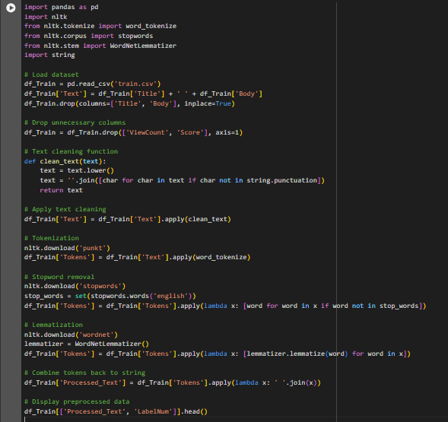
Code Snippet for MS2 Preprocessing

Slide 15
Selection of the Pre-trained Model

Slide 16
Criteria for Selecting a Pre-trained Mode
Task Relevance: Ensure the model's architecture and training objectives align with the task.
Performance: Evaluate the model's accuracy, F1 score, and other performance metrics.
Size and Efficiency: Consider the model's size and inference time, especially for deployment.
Community and Support: Choose models with robust community support and documentation.
Compatibility: Ensure the model integrates well with the chosen framework and tools.

Slide 17
Justification for the Chosen Pre-trained Model
Performance: Balances performance and computational efficiency, making it a practical choice for binary text classification.
Chosen Model: BERT-tiny
Efficiency: BERT-tiny provides a compact model suitable for faster inference, crucial for real-time applications.
Task Alignment: Pre-trained on masked language modeling, making it effective for understanding and classifying text.
Community and Support: Strong support and resources available through the Hugging Face Transformers library.
Performance: Balances performance and computational efficiency, making it a practical choice for binary text classification.
Implementation: Easy integration with PyTorch, facilitating seamless training and deployment processes.

Slide 18
Post-processing for Output: MS2 vs. MS3

Slide 19
MS2 Post-processing: Techniques Used
Label Mapping:
- Converting model output (logits) to human-readable class labels.
- Example: Mapping 0 to android and 1 to ios.
Confidence Thresholding: Applying a confidence threshold to filter low-confidence predictions.
Aggregation: Aggregating outputs from multiple instances to make a final decision.

Slide 20
Handling Model Outputs
Softmax Activation: Applying softmax to convert logits to probabilities.
Prediction Extraction: Extracting the class with the highest probability.
Logging and Tracking: Logging predictions and their confidence levels for further analysis.

Slide 21
MS3 Post-processing: Differences from MS2
Additional Post-processing Steps: Implementing more advanced techniques to refine predictions.
Error Analysis: Conducting thorough error analysis to understand misclassifications.
Feedback Loop: Integrating user feedback to improve model performance iteratively.

Slide 22
Additional or Alternative Post-processing Steps in MS3
Ensemble Methods: Combining outputs from multiple models to improve robustness.
Probability Calibration: Adjusting the predicted probabilities to better reflect true likelihoods.
Dynamic Thresholding: Adapting confidence thresholds based on context or input characteristics.

Slide 23
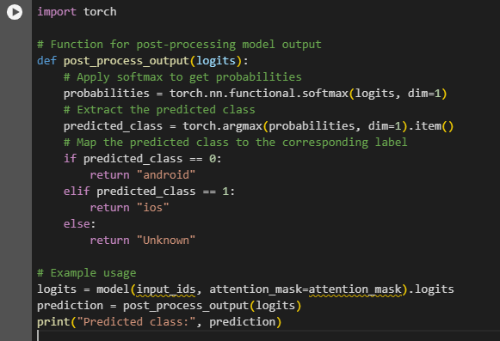
Code Snippet for MS2 Post-processing

Slide 24
Analysis of Architectures: MS2 vs. MS3

Slide 25
Limitations of MS2 and MS3

Slide 26
Limitations of MS2
Simpler Model:
- Relies on traditional machine learning techniques.
-May not capture complex patterns in the data.
Faster Training:
- Quick to train and deploy due to lower computational requirements.
- Suitable for smaller datasets or less complex tasks.
Limitations:
- Limited scalability and adaptability.
- May struggle with high-dimensional data or nuanced language understanding.

Slide 27
Limitations of MS3
More Complex:
Involves advanced model architectures and preprocessing techniques.
Can capture intricate patterns and nuances in the data.
Longer Training Times:
Requires significantly more time to train due to increased complexity.
Longer training cycles may delay deployment and iteration.
Computational Resources:
Demands higher computational power and memory.
May necessitate specialized hardware (e.g., GPUs, TPUs) for efficient training and inference.

Slide 28
Comparing Limitations
MS2:
Pros: Fast, less resource-intensive, simpler implementation.
Cons: Limited complexity, less effective with large or complex datasets.
MS3:
Pros: High complexity, better performance on nuanced tasks, scalable to larger datasets.
Cons: Resource-intensive, longer training times, more complex implementation.

Slide 29
Advantages Relative to the Task
MS2: Faster and simpler to implement, Suitable for less demanding tasks
MS3: More accurate and robust, Handles complex tasks better

Slide 30
Overall Understanding of Architectures and Limitations

Slide 31
Summary of MS2 and MS3 Architectures
MS2 Architecture:
Utilizes traditional machine learning techniques.
Features simpler models like logistic regression or support vector machines.
Relies on handcrafted features and preprocessing.
MS3 Architecture:
Incorporates advanced deep learning models like transformers.
Employs sophisticated preprocessing techniques and self-attention mechanisms.
Offers more flexibility and adaptability in capturing complex patterns in the data.

Slide 32
General Limitations
Implementation Challenges:
MS2: Limited by the choice of features and model complexity.
MS3: Demands significant computational resources and expertise in deep learning.
Data Availability: Both architectures require sizable labeled datasets for training, which may not always be readily available.
Model Interpretability: MS3 models, especially, can be difficult to interpret due to their complex architectures.

Slide 33
Findings and Discussion
MS3 shows improved performance but at the cost of higher complexity.
MS2 provides faster and simpler solutions, suitable for less demanding tasks. Balancing model performance with interpretability and resource constraints is crucial.

Slide 34
Updated Background in Literature Review

Slide 35
Integration of Recent LLM Advancements with MS2 and MS3 Approaches
Explanation of how recent advancements in LLMs have influenced MS2 and MS3 methodologies.
Discussion on the impact of LLMs on improving accuracy, scalability, and efficiency of MS2 and MS3 approaches.
Examples of how LLMs are being integrated into MS2 and MS3 frameworks for enhanced performance.

Slide 36
Unique Contributions of the Project
Explanation of how the current project contributes to the existing literature on MS2 and MS3 approaches.
Identification of novel methodologies, techniques, or insights introduced by the project.
Discussion on how the project addresses gaps or limitations in previous studies and adds value to the field of NLP.

Slide 37
Future Directions and Conclusion
Exploration of potential future research directions based on the findings of the current project.
Suggestions for further improvements or extensions to MS2 and MS3 methodologies leveraging recent LLM advancements.
Conclusion summarizing the significance of integrating LLMs with MS2 and MS3 approaches and the overall impact on the field of NLP.

Slide 38
Conclusion
Recap: Summarized key findings and methodologies.
MS2 vs. MS3: Compared approaches, highlighting pros and cons.
Future Directions: Identified open questions and suggested areas for further research.

Slide 39
Questions
Invite questions from the audience

